Slide 1

经典
CLASSIC
BLACK
AND
WHITE
黑与白
轻松应对不同场合需求

Slide 2

PPT
COMPANY NAME
DESIGNED BY NIGHT

Slide 3

领
2017
引领未来
TO LEAD THE FUTURE
航
中国高科技行业高端演示模板
For a country with such a strong economy and the luxury of throwing away unwanted food, you'd think Japan would be a happier country, but it also boasts one of the highest rates of suicide in any developed nation. Even Mount FUJI, a revered symbol of Japan, is a notorious suicide spot for the around 100 dead bodies discovered in the surrounding woodiness

Slide 4
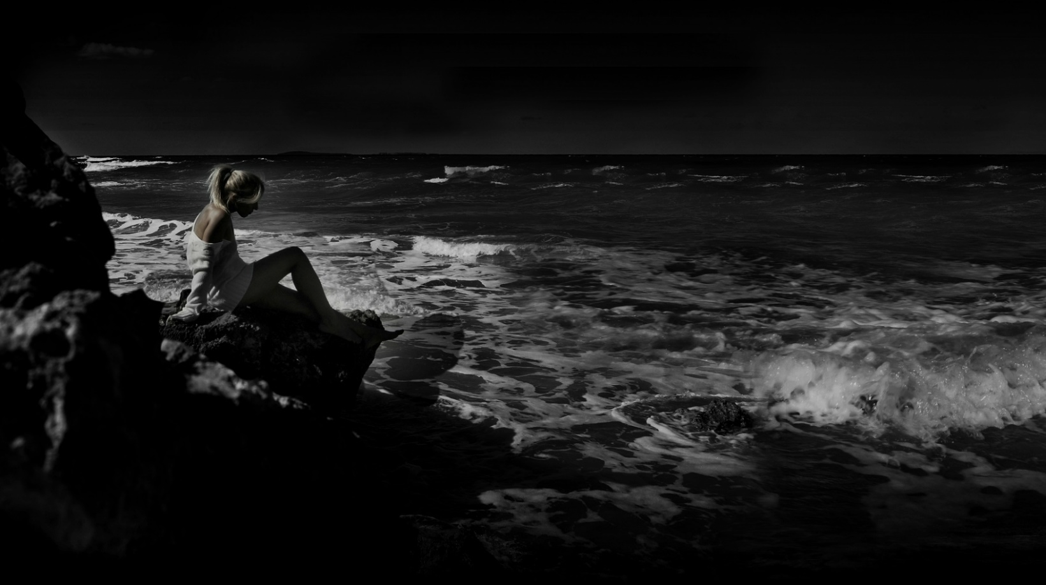
NEW AUTUMN
FASHION
2017
年终总结汇报模板
COOL/FASHION

Slide 5
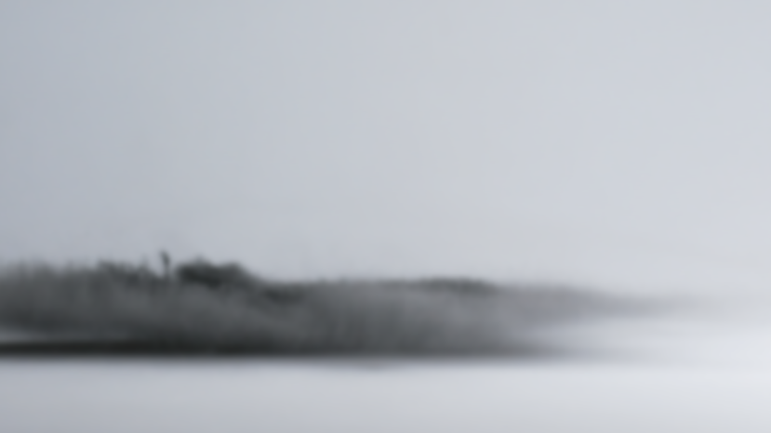
ABSTRACT
NIGHT DESIGN

Slide 6

FASHION
时尚通用模板
2017年时尚通用商务提报模板
BUSINESS REPORT

Slide 7

2017
OPENING SOON
2017年1月24日
——企业年终会主题活动模板
For a country with such a strong economy and the luxury of throwing away unwanted food, you'd think Japan would be a happier country, but it also boasts one of the highest rates of suicide in any developed nation. Even Mount FUJI, a revered symbol of Japan, is a notorious suicide spot for the around 100 dead bodies discovered in the surrounding woodiness

Slide 8

2017
NEW YEAR
Welcome

Slide 9
FASHION
INDE —
PENDENT
DAY
潮流
新风尚
=Designed by Night
2017年总结汇报模板

Slide 10
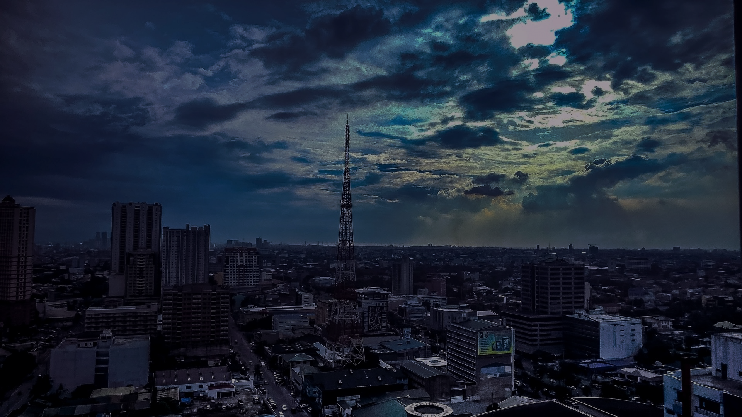
2017
商务总结汇报模板
BUSINESS REPORT

Slide 11
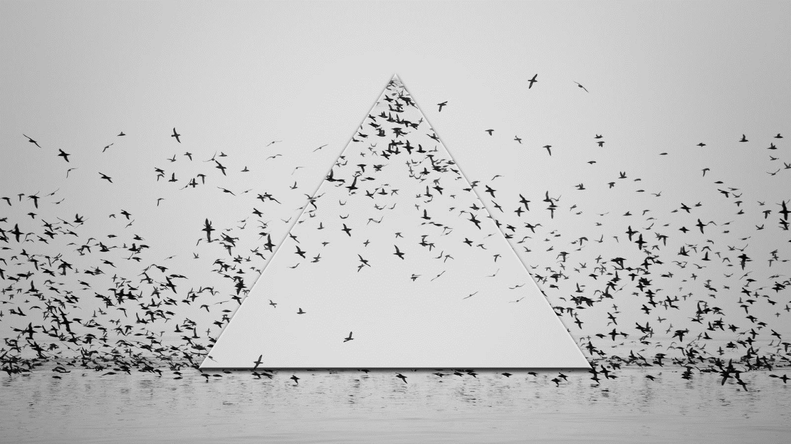
绝美展示 绝佳体验
BUSINESS REPORT
【年度计划总结报告】
2017 NEW BUSINESS ANNUAL REPORT
For a country with such a strong economy and the luxury of throwing away unwanted food, you'd think Japan would be a happier country, but it also boasts one of the highest rates of suicide in any developed nation

Slide 12

A
bout
关于我们
US

